Slide 1
Analog Video Capture with PCs Steve Preston IOTA Annual Meeting Oct 2015

Slide 2
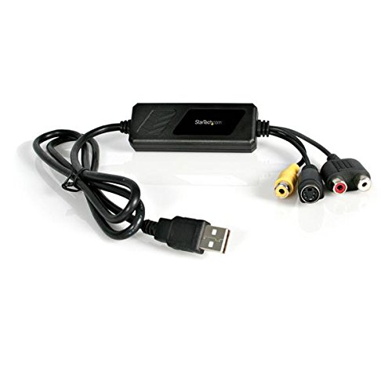
Analog Video Capture Hardware
Windows PC with an available USB2 port
StarTech SVID2USB2 : USB analog video capture “cable” ($50 on Amazon)

Slide 3
Analog Video Capture Software
Windows 7/8/10
Lagarith codec ( http://lags.leetcode.net/codec.html )
VirtualDub (http://virtualdub.sourceforge.net/ )

Slide 4
Software Setup
Lagarith codec ( http://lags.leetcode.net/codec.html )
Download the installer version of the codec and run the installer
Why Lagarith – lossless compression with enough speed and compression to avoid dropped frames. And – it works!
VirtualDub (http://virtualdub.sourceforge.net/ )
Download the zip file for the latest 32-bit or 64-bit windows release from the link above. If you aren’t sure if your system is 32 or 64 bit, use the 32 bit version.
Create a folder called "VirtualDub" under "c:/Program Files" or “c:/Program Files (x86)”; copy the contents of the zip file to the "c:/Program Files/VirtualDub" directory.
Create a shortcut to VirtualDub on the desktop: in desktop mode, view the VirtualDub directory in the Windows explorer (folder viewer), bring up the context menu for the file VirtualDub.exe ("touch" the file, hold for two seconds, then release the touch), and select "create shortcut".

Slide 5
Software Setup
StarTech SVID2USB2 driver install
Copy the driver files: The SVID2USB2 comes with a DVD. Copy the subdirectory called "driver" from the DVD to a folder on your computer (e.g c:/StarTech).
Install the drivers:
go to the "driver" subdirectory (e.g. c:/StarTech/driver/ ) and run "setup.exe" to install the drivers.
Plug the StarTech SVID2USB2 into a USB port on your computer. If Windows brings up a dialog for installing drivers, just close it.

Slide 6
Basic Video Capture steps
Connect the hardware
Video input: connect the video camera/VTI video output to the video input of the SVID2USB2 (yellow RCA connector).
Plug the USB connector of the SVID2USB2 into a USB2 port of your computer.
Start VirtualDub
Start VirtualDub (double click on desktop shortcut)
Start Capture Mode: File/Capture AVI
Select the SVID2USB2: From the menu, select "Device", then "USB 2821 Device". VirtualDub should now show live video in the capture window.
Set the video compression: From the menu, select "Video", then "Compression", then select "Lagarith Lossless codec". VirtualDub will remember this setting so you this should be a one-time setting.
Set the capture file: File/Capture File or F2 and enter a filename.

Slide 7
Basic Video Capture steps
Start / Stop Capturing
Start capturing video – F6 (or Capture/Capture Video from the menu)
Stop Capture: ESC key (or Capture/Stop capture from the menu)
File size
With the Lagarith codec, occultation video files should be about 4GB for a 10 minute recording.

Slide 8
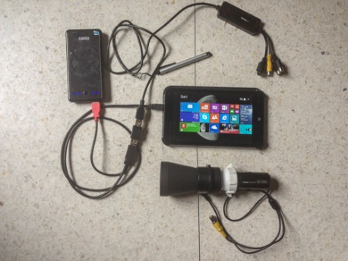
Portable Analog Video Recorder
HP Stream 7 ($99) : 7” Windows 8 Tablet PC
StarTech SVID2USB2 ($50)
StarTech USB2HAUBY3 ($5) : Y-cable USB to Micro-USB OTG
USB Coupler – Female to Female ($5)
Capacitive Touch Stylus ($6)
Anker 10000mAh power bank (optional - $25)
Total Cost : less than $200

Slide 9
Portable Analog Video Recorder
Software
Lagarith video codec (free)
VirtualDub (free)
VDocc (free) – modified version of VDTimer
Simple user interface for tablet
Timer mode for unattended recording
Download via http://www.netstevepr.com/hp_stream_7_video_recorder.html

Slide 10
Portable Analog Video Recorder
Functionality
Records analog video to AVI file (Lagarith codec)
Manual mode – start / stop while attended
Timer mode – start / stop via timer
Recording Time
30 min of recording time with NO additional SD card
Power
With HP Stream 7 internal battery ONLY : about 3 hours of standby
With 10000 mAh power bank : 11 hours of standby time
With 8 pack of AA Rechargeable NiMH : 6 hours
With 8 pack of AA Lithium batteries : 8 hours
With AC power source : over 24 hours of standby time
Notes:
See http://www.netstevepr.com/hp_stream_7_video_recorder.html for more info.

Slide 11
Portable Analog Video Recorder
HP Stream Settings/Tips
Sync with Microsoft Account – should turn this off to save space for video files.
Enable “standard” keyboard
Disable “auto-rotate”
Power management – NEVER SLEEP (even on battery power)
Setup “iota” user account – useful if you will lend the device to others
Airplane mode – use this when observing to avoid unexpected “pop-ups” from windows.
More details/info at http://www.netstevepr.com/hp_stream_7_video_recorder.html

Slide 12
VDocc Program
Install : No real install - just copy the program file to a directory and double-click the program file to start VDocc
Settings :
VirtualDub.exe location – VDocc will look in the default locations. But you may specify a different location.
Capture directory – the directory where the AVI capture file will be saved.
Hibernate – option to put the Stream7 in hibernate mode after a timer recording (recommended).

Slide 13
Viewing/Analyzing AVI Files
Lagarith codec – must be installed on the machine you use to analyze/view the video files.
LiMovie
Set to use DirectShow : menu item Option/Update Setting Items , File Reading pane, check Direct Show option.
Tangra
No special requirements

